Slide 1
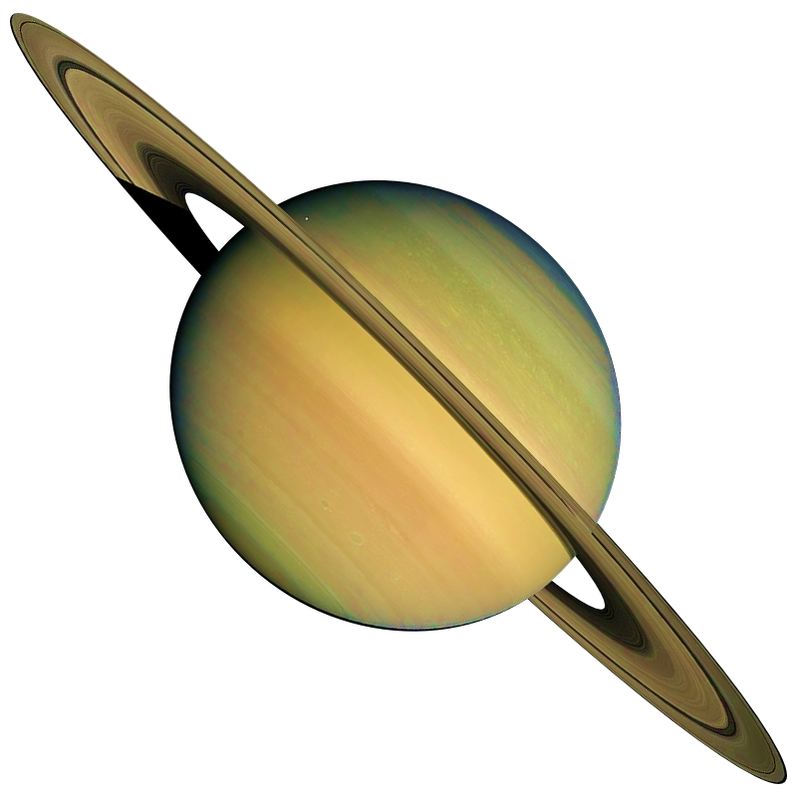
5
MIND BLOWING FACTS ABOUT SATURN

Slide 2
SATURN'S RINGS ARE NOT SOLID.
THEY ARE MADE UP OF BITS OF ICE, DUST AND ROCK.

Slide 3
IF YOU WERE TO PUT SATURN IN WATER, IT WOULD FLOAT.

Slide 4
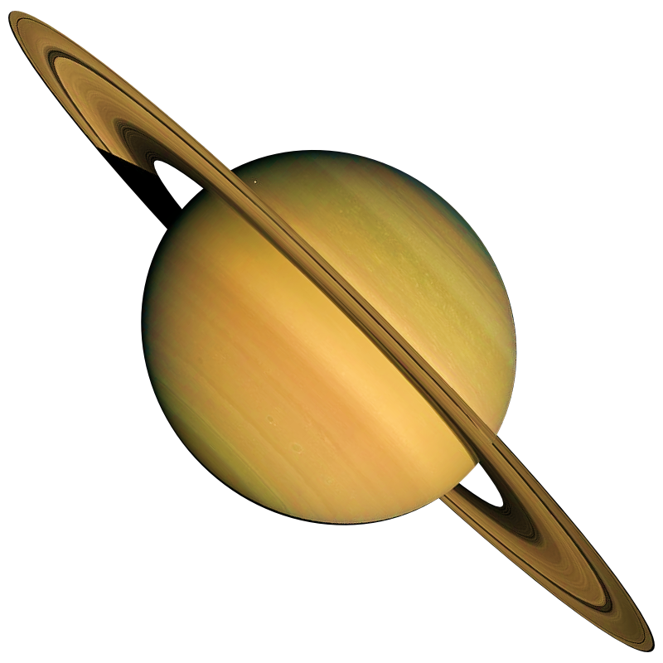
SATURN'S RINGS
ARE ONLY
30 TO 300 FEET (9 TO 90 METERS) THICK.

Slide 5
LIKE JUPITER,
SATURN IS A GAS GIANT
AND IS COMPOSED OF SIMILAR GASSES INCLUDING
HYDROGEN,
HELIUM
AND
METHANE.

Slide 6
SATURN HAS
150 MOONS
AND
SMALLER MOONLETS.

Slide 7
THANK YOU

